Slide 1
Metal Casting
Visit for more Learning Resources

Slide 2
CO
Identify and select proper manufacturing process for a specific component.

Slide 3
METAL CASTING
History of Casting
Why Casting?
Basic casting process
Basic terms used in casting
Steps in casting process

Slide 4
Introduction
A process based on the property of liquid to take up the shape of the vessel containing it.
A cavity of desired shape is made, contained in a mold.
Carried out in a foundry.

Slide 5
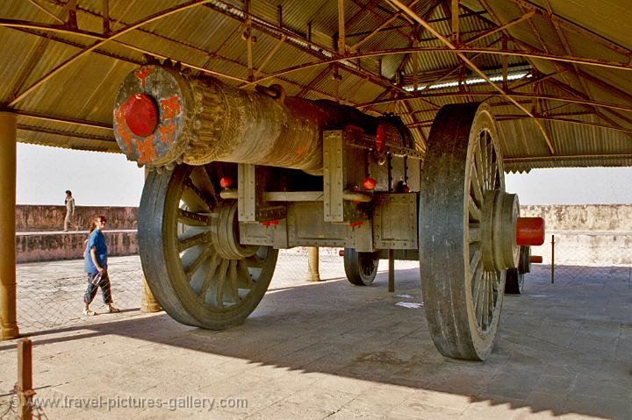
History of Casting
Ancient process, started 5000 years ago.
Jaivana- 50 tons cannon was built in 17th century in Jaipur.
Used for making arrows, coins, knives etc.
World’s largest Cannon in
Jaipur, made by casting

Slide 6
Why Casting?
A job of 5m diameter and 10m length.
A job with a hole of 2m diameter, made of very hard material.
Parts of very complicated shapes.

Slide 7

Have you seen any similar process before?
What do we control?
Size & shape of cavity and mold
Mixture composition
Temperature
Cooling time
Carefully remove it

Slide 8
Requirement for Casting?
Cavity of desired shape- Mold
Molten metal
Proper channel to fill the molten metal

Slide 9

Basic Casting Process

Slide 10
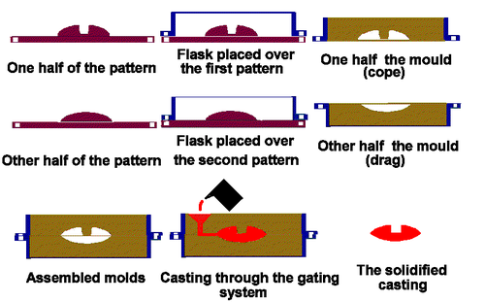
Basic Casting Process

Slide 11
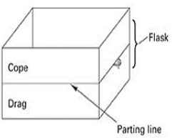
Basic terms used in Casting
Pattern: Replica of the desired part
Mold- Container with a cavity within. Divided in two halves: Cope and Drag.
Gating system- Network of channels that deliver molten metal to the cavity.

Slide 12
Basic steps in Casting
Pattern making
Mold making
Melting of metal and pouring
Cooling and solidification of metal
Cleaning of casting and inspection

Slide 13
Pattern
Replica of the desired product
Has somehow different dimensions than the actual part to be manufactured
Used to form the mold cavity
Materials used
Types of patterns
Pattern Allowances

Slide 14
Pattern Materials
Requirements:
Easily shaped, worked, machined and joined
Resistant to wear and corrosion
Resistant to chemical action
Dimensionally stable
Easily available and economical

Slide 15
Pattern Materials
Wood:
Easy availability, low weight and low cost
Can be easily shaped
More than 90% castings use wood patterns
Absorbs moisture. So, distortions and dimensional changes occur
Relatively lower life, hence suitable for small quantity production

Slide 16
Pattern Materials
2. Metal:
Used for large quantity production and for closer dimensional tolerances
Longer life
Aluminum is mostly used.
Other metals: cast iron, brass etc.

Slide 17
Pattern Materials
3. Plastic:
Low weight, easier formability, smooth surfaces and durability
Do not absorb moisture. So, dimensionally stable
Corrosion resistance

Slide 18
Pattern Materials
4. Polystyrene:
Changes to gaseous state on heating
Disposable Patterns. Hence, suitable for single casting.
When molten metal is poured into cavity, polystyrene transforms to gaseous state.
Used mostly for small and complicated shaped castings.

Slide 19
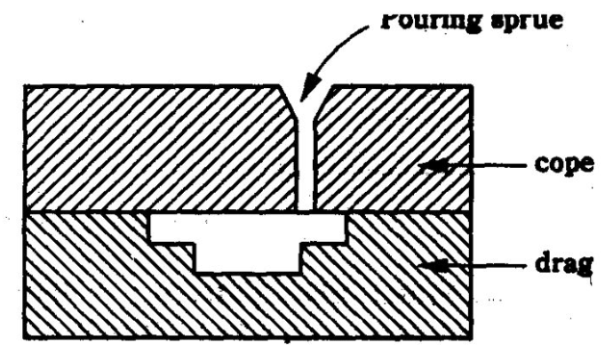
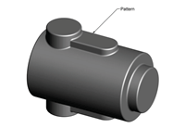
Pattern Types
1.Single piece pattern:
Used for simple shaped & large castings.
Pattern and cavity produced by it are completely in the lower flask (i.e. drag)
Causes difficulty in making the mold.

Slide 20
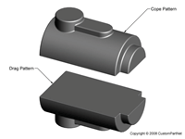
Pattern Types
2.Split pattern:
Split pattern models the part as two separate pieces that meet along the parting line of the mould
Two parts are aligned by Dowel pin.

Slide 21
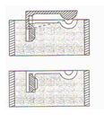
Pattern Types
3.Loose Piece pattern
As pre The name Pattern Contain One or more than one loose piece
Loose piece is used to make removal of pattern easy from mould box
loose pieces are attached to main body with the help of dowel pins or wire
First main pattern is drawn and then carefully loose pieces
Moulding with this pattern is expensive and require more skill

Slide 22
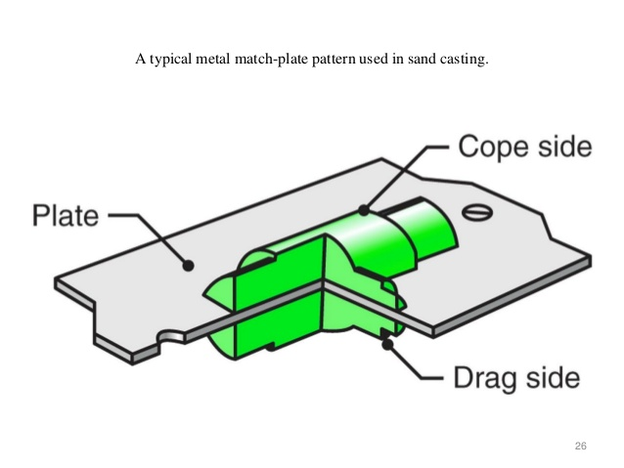
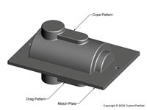
Pattern Types
4. Match-plate pattern:
Similar to a split pattern, except that each half of the pattern is attached to opposite sides of a single plate.
Match plate confirms the parting line
Ensures proper alignment of the mould cavities in the cope and drag and the runner system can be included on the match plate.
Used for larger production quantities.
Ic Engines piston rings

Slide 23
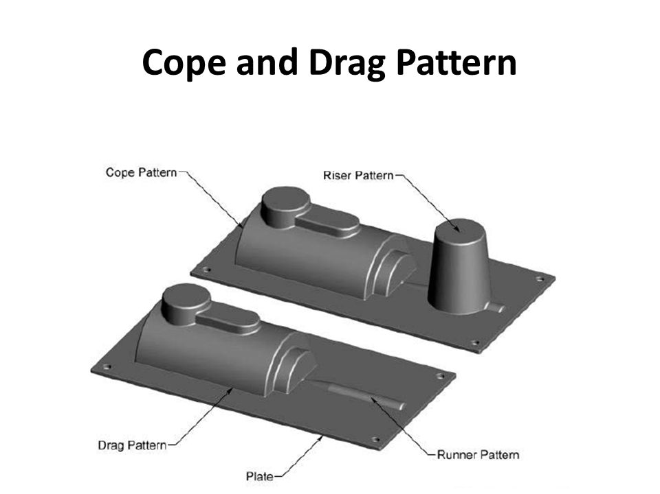
Pattern Types
4. Cope-Drag pattern:
It is similar to split pattern
Each half of the pattern is attached to a separate plate and the mould halves are made independently.
.Pattern is made in two halves and split along parting line
These two halves are known as cope and drag
There moulding done independently
After moulding they are assembled to form complete mould box
Often desirable for larger castings

Slide 24
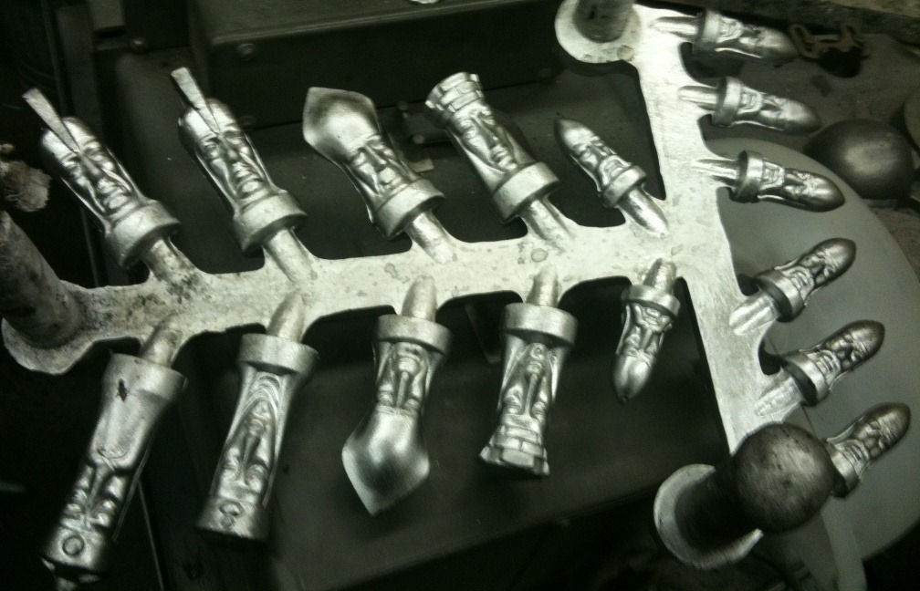
Pattern Types
5. Gated pattern:
In this patters of gate and riser or runner are permanently attached to regular pattern
They are used to manufacture multiple casting in on time
Each pattern is connected with common runner .
Suitable for pouring small castings and for mass production
It save labour and time

Slide 25
Pattern Allowances
Shrinkage or contraction allowance
Draft or taper allowance
Machining or finish allowance
Distortion or camber allowance
Rapping allowance

Slide 26
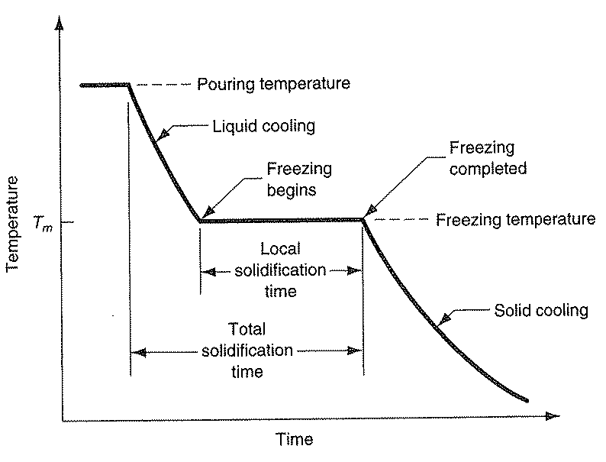
Pattern Allowances
Shrinkage Allowance:
Liquid Shrinkage
Solid Shrinkage

Slide 27
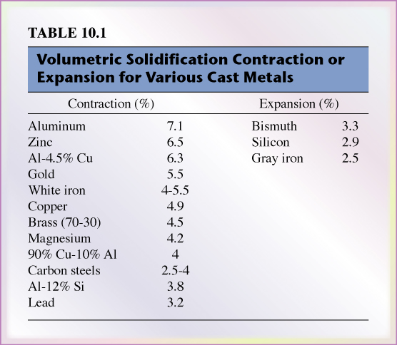
Pattern Allowances

Slide 28
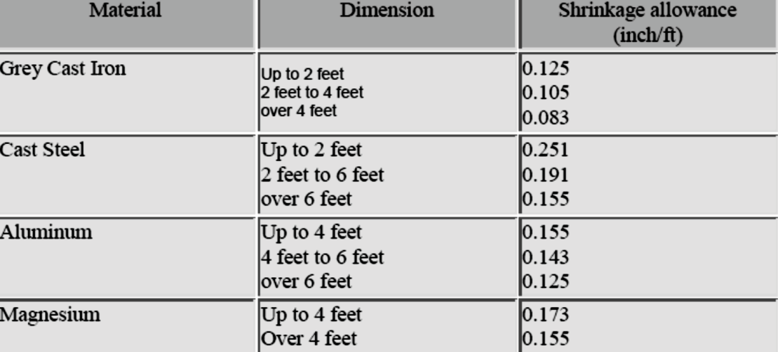
Pattern Allowances
Shrinkage Allowance:
Shrinkage means contraction of metal on solidification
All metals shrink after solidification. (Except grey cast iron that expands on solidification).
It is expressed in mm/m.
Shrinkage allowance Differs from material to material.
Positive type of allowance.

Slide 29
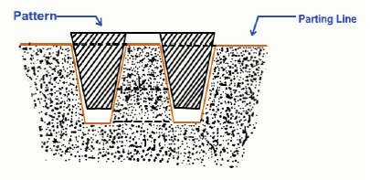
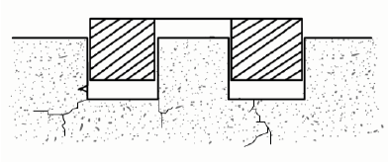
Pattern Allowances
Draft / Taper Allowance:
Taper provided by the pattern maker on all vertical surfaces of the pattern so that it can be removed from the sand without tearing away the sides of the sand mould.
Inner details of the pattern require higher draft than outer surfaces.
commonly applied draught allowance is 1°to 3°
due to draught allowance pattern can easily removed from mould box

Slide 30
Pattern Allowances
Draft / Taper Allowance:
The amount of draft depends upon-
The length of the vertical side of the pattern to be extracted;
The intricacy of the pattern;
The method of moulding
Pattern material.

Slide 31
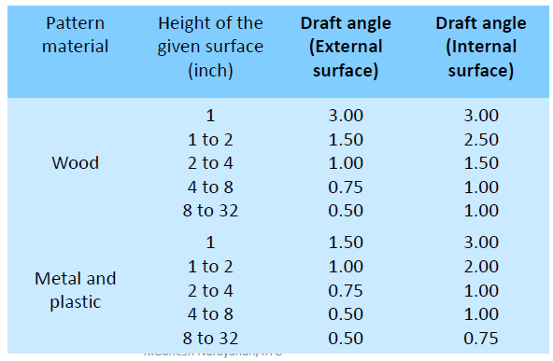
Pattern Allowances

Slide 32
Pattern Allowances
Machining / Finishing Allowance:
The finish and accuracy in sand casting is generally poor.
Extra material provided on the casting to enable their machining or finishing to the required size, accuracy and surface finish.
So it is Added in pattern dimensions.
allowance is provided only in machining area
Amount of machining allowance depends upon:
Method of moulding and casting used
Size and shape of casting
Casting orientation
Metal used in casting
Degree of accuracy and finish required

Slide 33
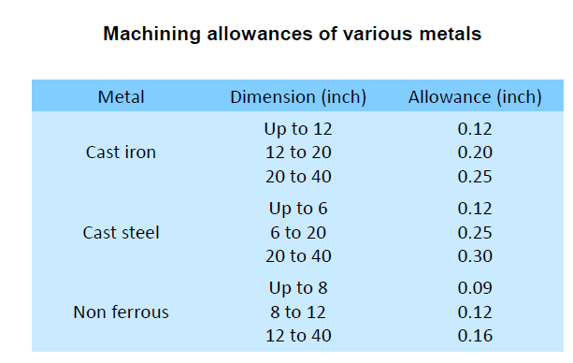
Pattern Allowances

Slide 34
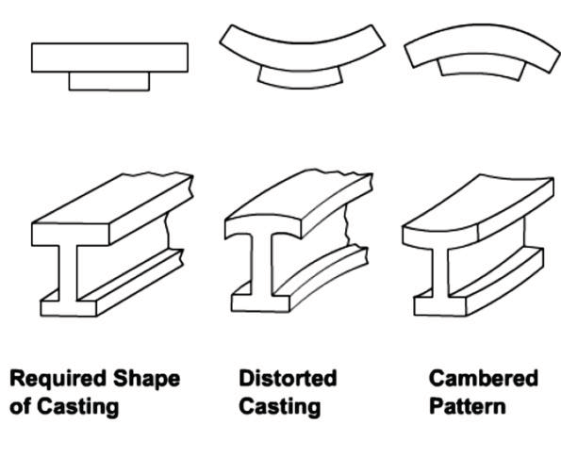
Pattern Allowances
Distortion / Camber Allowance:
Due to their typical shapes (U,V,T,L shapes) , castings get distorted during solidification.
Distortion is observed in irregular castings so that it shrink in uneven manner
Distortions are caused by internal stresses which are generated on account of unequal cooling of different sections of casting.
To avoid this distortion allowance is provided
It varies from 2 to 20 mm

Slide 35
Pattern Allowances
Rapping / shake Allowance:
Before the withdrawal from the sand mould, the pattern is rapped all around the vertical faces to enlarge the mould cavity slightly, which facilitate its removal.
When pattern is rapped, mould cavity is enlarged.
To account for this increase, pattern size is reduced.
This allowance is important in large-sized castings and precision castings.
Amount of rapping allowance depends upon:
Extent of rapping
Degree of compaction of sand
Size of mould
Sand type

Slide 36
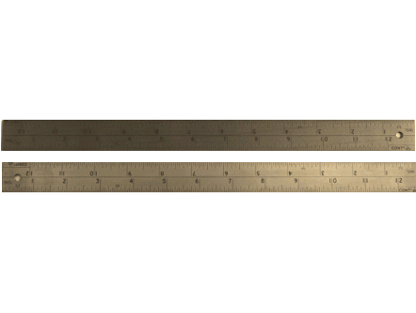
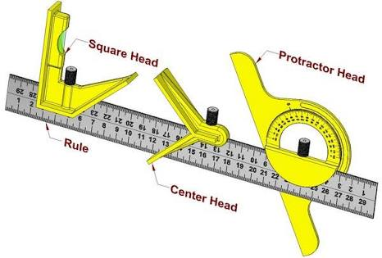
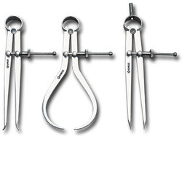
Tools
It include carpenter tools and some special tool
Contraction scale- It is used to measure pattern dimensions include various allowances.It is metallic scale of 300 or 500 mm length
Combination set- It generally used for pattern making.It is used to measure angles,pependicularity,locate centre on cylindrical job.
Callipers- They are of internal or external type.Generally used to measure internal or external diameters of patterns.

Slide 37
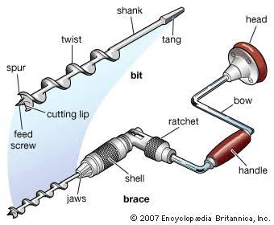
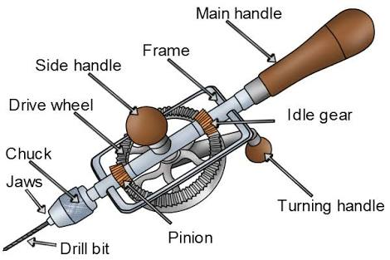
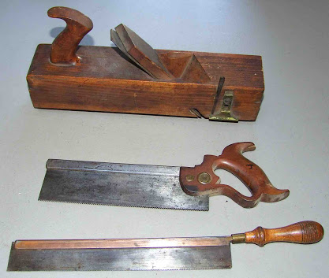
Tools
Ratchet brace- This is used to drill holes in horizontal and vertical plane.
Wheel brace- It produce only small holes. It can drill small holes accurately nd quickly.
Back saw and plane- They are used for Curtin and parting operations.

Slide 38
COLOUR CODING FOR PATTERN
Pattern are coloured by using shellac paints.
Colours gives protection and identifies the features of patterns.
colour scheme is given as bellow
Colour | Indication
Black | Unfinished surface on casting
Red | Finished surface on casting
Yellow | Core prints
Black | Parting surface
Red/yellow strips | Seats for loose piece

Slide 39
COLOUR CODING FOR PATTERN

Slide 40
Moulding
The term moulding process refers to the method of making the mould and the materials used.
Moulding processes have certain features in common-
The use of pattern.
Some type of aggregate mixture comprising a refractory and binders.
A means of forming the aggregate mixture around the pattern.
Hardening of aggregate or developing its bond while in contact with the pattern.
Withdrawal of the pattern from the mould.
Assembly of the mould and core pieces to make a complete mould, metal then being poured into the mould.

Slide 41
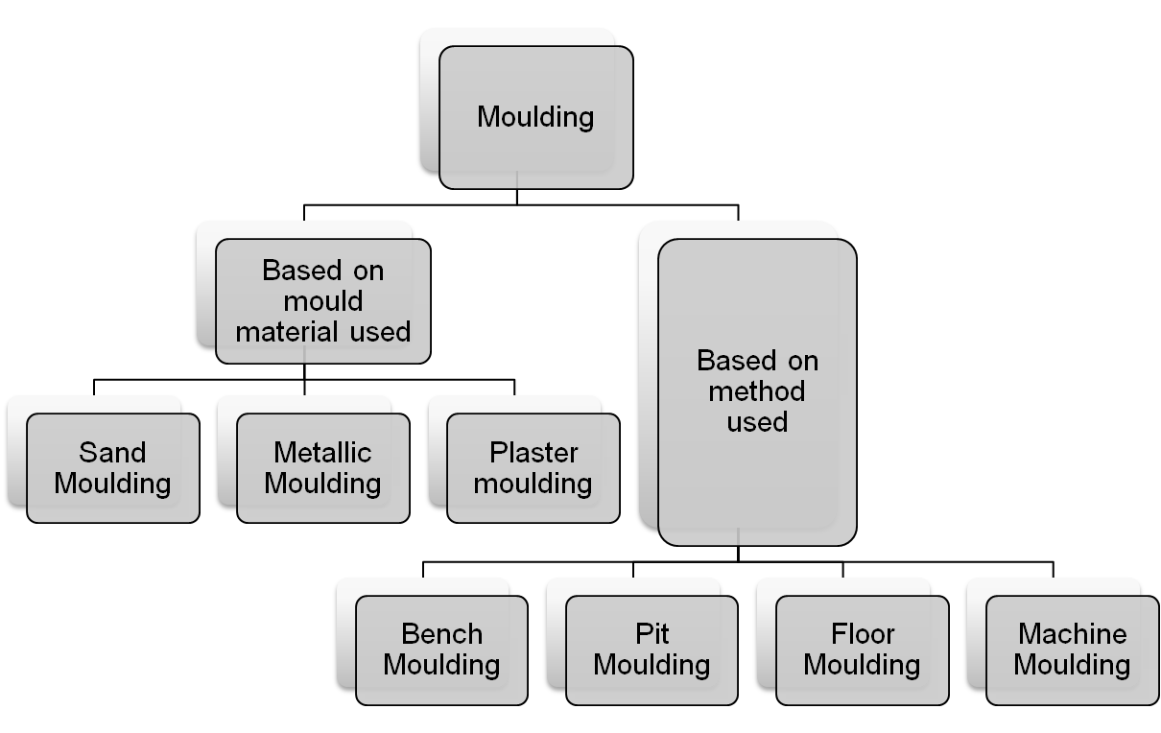
Moulding
Classification of Moulding Processes:

Slide 42
Types of Moulding Sands
Green Sand:
Natural sand prepared as a mixture of silica sand with 18-30 % clay and 6-8 % moisture.
Fine, soft, light and porous.
The name ‘Green sand’ employs for damped i.e. it contains moisture and the mould made of this sand is used immediately to pour the molten metal.
Easily available and has low cost.

Slide 43
Types of Moulding Sands
Dry Sand:
Green sand that has been dried or baked in between 250° to 550° in suitable oven after the making mould and cores, is called dry sand.
More strength, rigidity and thermal stability.
Suitable for larger castings.

Slide 44
Types of Moulding Sands
Parting Sand:
It is used to keep away the green sand from sticking to the pattern and to allow the sand on the parting surface of the flasks to separate without clinging.
It is free from clay and is dry.
It is washed and non sticky sand

Slide 45
Types of Moulding Sands
Core Sand:
Used to make core.
Should be stronger than the moulding sand.
It is made by mixing core linseed oil with silica sand,
It is also called as soil sand

Slide 46
Backing sand
It usually contains burnt facing sand, moulding sand and clay.
It is old and repeatedly used sand and used for baking facing sand
It is filled behind the facing sand in the mould box or flask.

Slide 47
Facing sand
It is mixture of floor sand and new moulding sand with suitable binder and moisture.
It is used next to the parting surface and comes in contact with molten metal when poured into the mould
It is used around a pattern to cover it upto 2.5 to 5cm

Slide 48
Properties of Moulding Sand
Refractoriness:
The ability of moulding sand to withstand high temperatures without breaking down or fusing.
The degree of refractoriness depends on SiO2 content and shape & grain size of the particle.
To enhance the proporty, sand should have lower percentage of lime, magnesia, alkali, oxides of metals.
Refractoriness is measured by Sinter point rather than its melting point. ( At sintering temperature, the moulding sand adheres to the casting)

Slide 49
Properties of Moulding Sand
2. Permeability:
Also referred as porosity, is the property of sand allow the escape of any air, gases or moisture present or generated in the mould when the molten metal is poured into it.
Liquid metals cause evolution of gases due to their reaction with moulding sand ingredients.
Permeability is a function of:
Grain size
Grain shape
Moisture and clay contents in the moulding sand.

Slide 50
Properties of Moulding Sand
3. Cohesiveness:
Also referred to as the strength of sand.
It is property of moulding sand by virtue which the sand grain particles interact and attract each other within the moulding sand.
Moulding sand should be capable of withstanding the compressive and erosive force exerted by liquid metal while filling the cavity.
Low strength mouldings result in defective castings.
It depends upon the grain size, sand particle shape and size, moisture content and density,
strength inversely affect the porosity

Slide 51
Properties of Moulding Sand
4. Flowability:
It is the ability of the sand to get compacted and behave like a fluid.
It will flow uniformly to all portions of pattern when rammed and distribute the ramming pressure evenly all around in all directions.
In general, flow ability increases with decrease in green strength, an, decrease in grain size.
flow ability also varies with moisture and clay content.
It is also called as plasticity fluidity.

Slide 52
Properties of Moulding Sand
5. Adhesiveness:
It is property of moulding sand to get stick or adhere with foreign material such sticking of moulding sand with inner wall of moulding box.
It helps the sand to retain the mould cavity and stay in the box.

Slide 53
Properties of Moulding Sand
6. Collapsibility:
After solidification of the molten metal, the casting is required to be removed from the mould.
If the moulding sand is easily collapsible, free contraction of the metal as well as easy removal of the casting is possible.
If the sand is not collapsible, it will strongly adhere to the casting, becoming very hard to separate after metal solidification.

Slide 54
Core and core print
Core is metal or sand body, which is set into the prepared mould before closing or pouring it .
These are used to produce holes, projections, cavities in casting.
core is kept on seat in the mould box prepared by pattern.
Projection is made in mould box during moulding process.
these projections made on mould box are known as core print.

Slide 55
Types of cores
Horizontal core.
vertical core.
Balanced core.
Cover core.
Drop core.

Slide 56
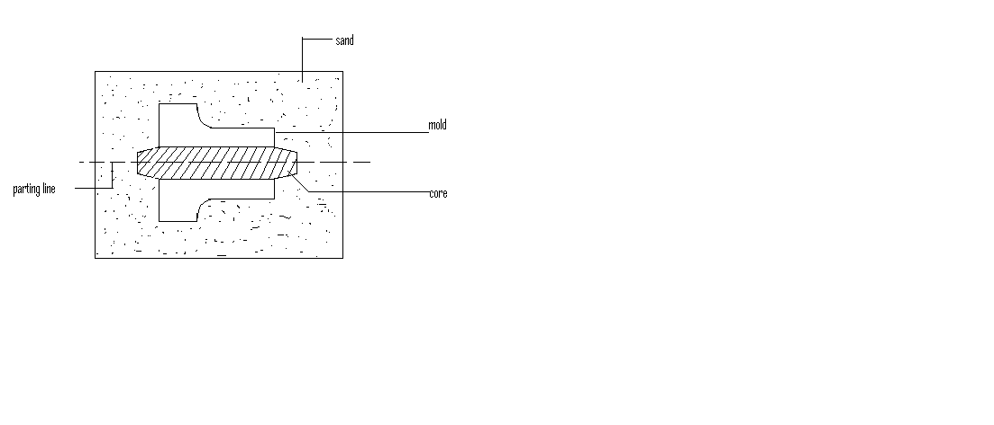
Types of cores
1. Horizontal core.
As par the name it kept horizontally in the mould box.
Its position is along parting line.
It is commonly used in foundary.

Slide 57
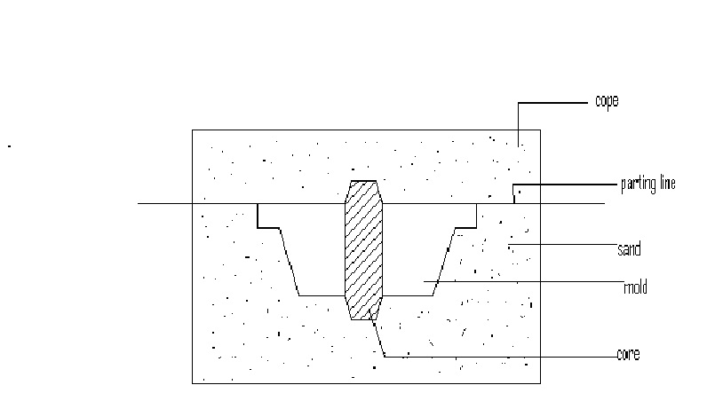
Types of cores
2.Vertical core.
Its is placed vertical in mould box.
It occupies cope and drag.
both the ends are rest in the core seat provided in the cope and drag.
both the ends are tapered and maximum portion is located in drag.

Slide 58
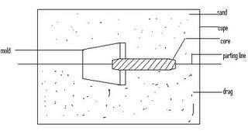
Types of cores
3.Balanced core.
only blind holes or holes which are open at one side are produced by balanced casting.
Balanced core has only one core print to maintain alignment of core
core print and portion of core outside the mould cavity is kept slightly larger and heavier

Slide 59
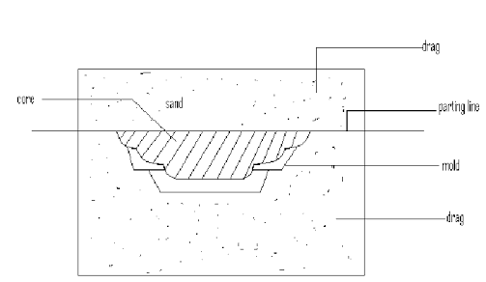
Cover core
It is supported on drag and completely moulded in drag
Core serve as cover for the mould

Slide 60
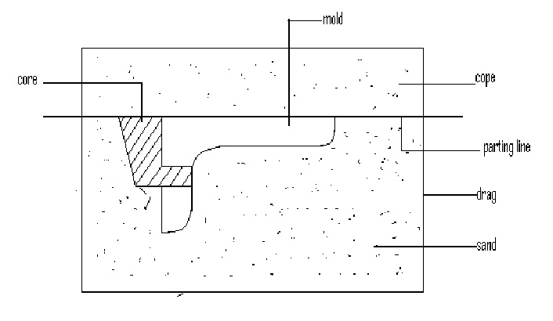
Drop core
It is used to produce holes in casting above or bellow the parting line.
taper is provided to side of core for way placement

Slide 61
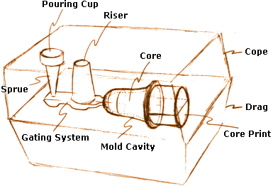
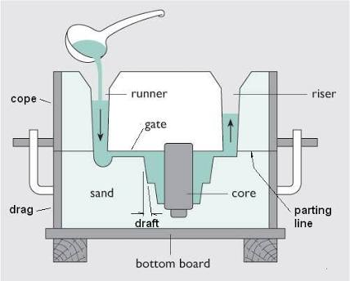
Elements of gating system

Slide 62
Types of moulding
Bench moulding
In this method small mould are made upon bench
It is used to manufactured the green sand and dry sand mould.
loose piece patterns are used for moulding.
Ramming is done manually.
Slow process and requires labours.
it is having types
Two box moulding.
Three box moulding.
stacked moulding.

Slide 63
Floor moulding
It is used for medium and part casting.
It is carried out on the floor.
In this moulding floor is act as drag and cope is rammed.
It is time consuming.
It requires labour.
green sand and dry sand mould are made by this method
It is also called as bending.
Ex.wheels,pulleys,plates with ribs etc

Slide 64
Pit moulding
It is used for large casting manufacturing.
Pit is dug in the floor of foundry with bed of charcoal placed at the bottom of pit to help the escape of gases.
cope is placed over the pit to complete the assembly.
Sand is rammed and wall of pit are bricklined and plastered with Liam sand.
Moulds are baked before pouring.
Gates , runner, riser, pouring basin are made in cope.
crane are used to lift the cope and position over drag.

Slide 65
Machine moulding
It is suitable for large production
It consist of following steps
Ramming of sand by jolting,squeezing in mould.
Rolling of mould through 180°.
Drawing of pattern from the mould by raising or lowering mould halves.
Types of machines used for making moulds are
Jolt moulding machine.
Jolt squeeze machine
sand slinger

Slide 66
Types of Casting Methods
Centrifugal casting.
In this process mould is poured and allowed to solidify during revolving.
Due to rotation of mould the poured metal is subjected to centrifugal force.
Centrifugal force is allowed molten metal to flow in the mould cavity.
Dence metal is deposited on periphery of mould and start sophistication.
Lighter slag, oxides, inclusions are get separated and moves towards centre.

Slide 67
Centrifugal casting
There is no use of gates runner and riser.
The axis of rotation may be horizontal or vertical.
Applications
Pipes , cylinder liners, bearings, bushes, gears fly wheels, gun barrels etc.

Slide 68
Shell moulding
This process is used for smooth surface finish
It consist of dump box which is partially filled with silica and thermoelectric resin.
Then dump box is sealed with metallic pattern which is preheated about 250°c.
When dump box is inverted mixture is get melted and forms the shell on pattern plate.
Shell thickness varies from 5mm to 8mm.
These two shells joint togather to form complete mould.

Slide 69
Shell moulding
Applications.
small pulleys ,motor housing, fan blades, cylinders, cylinder heads, break drums.

Slide 70
Investment casting
It is also known as lost wax casting precision casting.
This method is used for manufacturing jewellry,dental goods.
It involves following steps.
Making of wax pattern sometimes mercury or plastic may be used.
provide wax made gates, runners, riser to the pattern.
Complete wax pattern put in box and filled with liquid mould material.
liquid around wax pattern solidifies and form mould
Then mould is heated to 150°to 800°c to remove wax

Slide 71
Investment casting
Applications.
surgical instruments.
vanes and blades for gas turbine.
costume jewellery.
valve bodies.
Reciprocating slides for cloth cutting machine.

Slide 72
Casting defects
Following are the casting defects arises during faulty processes in casting.
Blow holes.
Pin holes.
Shift.
Short runs.
Hot tears.
cold shuts.

Slide 73
Blow holes
Blow holes are spherical, flattened or elongated cavities present in the casting .They are formed due to following reasons.
Reasons.
Rapid evolution of gas from mould.
Lack of porosity in mould box.
Excess moisture in sand.
Hard ramming of sand.
Remedies
Moulds and cores are properly vanted.
Avoid hard ramming.
Proper amount of moisture in sand.
Proper grain size of sand.

Slide 74
Pinholes
Pin holes are small holes of less than 2mm diameter which are on surface or bellow the surface of casting.
Causes.
High pouring temperature.
Gas dissolved in molted metal.
gases are not removed properly from molted metal.
Sand with higher moisture content.
Remedies.
Maintain pouring temperature.
increase flux proportion.
reducing moisture content in sand.
Effective regarding.

Slide 75
Shift
It is external defect arises due to mis allotment parts of casting.
Causes.
Core displacement.
Misalignment of cope and drag.
warn out or burn out of clamping pins.
Misalignment of two halves of pattern.
Remedies.
Repair or replacement of dowel pins.
Proper alignment of pattern.
Proper alignment of cope and drag.
Repair clamping pins.

Slide 76
Short run
It is also called as Morin.
when cavity in mould is filled incompletely then short run introduces.
Causes.
Insufficient metal supply.
lack of fluidity in molten Merkel.
Molten metal temp is low.
faulty gating system.
Remedies.
Adjust pouring temp.
Adjust rate of pouring.
Modifications in gating system.

Slide 77
Hot tears
It is also called as pulls or hot crack.
They may be internal or external.
They having dark blue in appearance on surface.
Causes.
Lack of compatibility of core.
high temp of casting metal.
incorrect design of batting system.
Lack of fillets and corner redii.
Remedies.
Improved design of casting.
Improved compatibility.
Proper solidification.
correct pouring temp.
For more detail contact us

